Slide 1
QUIZZO
A fun multiplayer quizzing platform
UTHKARSH SRINIVASAN

Slide 2
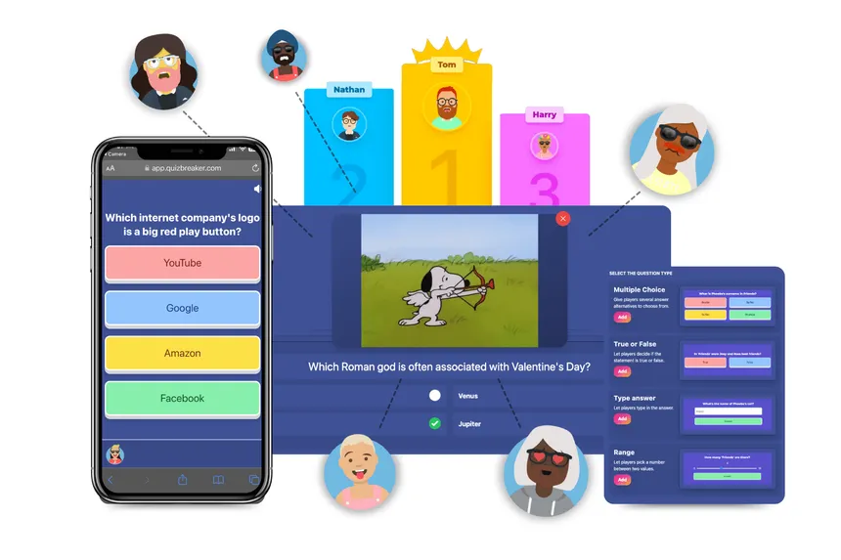
Purpose/Goal
Create a multiplayer quiz server that enable players to answer questions at their own pace with choices across different categories.

Slide 3
Design Implementation
Server Setup:
TCP socket-based communication.
Handles up to 2 clients concurrently via multithreading.
send_to_all(): Sends a message to all connected clients. This is used to broadcast questions, scores, and other updates to both players.
roll_dice(): Generates a random number between 1 and 6 (simulating a dice roll) for determining who chooses the category.
send_question(): Sends the current question and its options to the clients based on the selected category.
display_scoreboard(): Displays the final scoreboard after all questions are answered. It compares the scores of both players and announces the winner.
check_answers(): Compares the player’s answer to the correct one. If correct, their score increases.
handle_client(): This is the main thread function for handling each client.
Game Flow:
Players roll dice to choose categories.
Players answer questions at their own pace.
Final scoreboard displays after all questions are answered.

Slide 4
THANK YOU

